Slide 1
EUMM
How to Participate to Simplified & Negotiated Procurement Procedures for the Supply & Service Contracts
By EUMM Procurement Team
By AUTHOR

Slide 2
PURPOSE
The purpose of this webinar is to provide Georgian companies with information and guidelines on how to benefit from EUMM business opportunities, by participating to procurement procedures
In Particular, this presentation will explain the Simplified Procedure (SP) and Negotiated Procedure (NP) for the procurement of Supplies & Services which has two main features:
SP for Supplies: Value above 20,000 EUR but lower than 100,000 EUR.
SP for Services: Value above 20,000 EUR but lower than 300,000 EUR.
Competition - at least three companies to be invited in SP; even one company may be invited in NP.
No negotiation of contract terms, specifications, terms of reference, price, etc. are allowed in SP, in contrast to NP, where negotiations are allowed.

Slide 3
EXCLUSION AND SELECTION CRITERIA
Which companies can participate to SP and NP for the supply of goods and for the provision of services to EUMM?
Exclusion criteria
Selection criteria
These criteria are related to situation in which a supplier might fall, such as
Bankruptcy
Breach of taxes and social security obligations
Grave professional misconduct
Corruption or distortion of competition
Money laundering
Financing terrorism
Child labour
Etc.
These criteria are related to the subject matter of the procurement procedure and include
Financial capacity, such a minimum required turnover that proves the supplier’s capacity to financially handle the contract
Professional capacity, such as a minimum number of staff employed
Technical capacity, such as past execution of similar contracts
FIXED
DECIDED BY EUMM

Slide 4
TENDER DOSSIER
When invited to participate to SP and/or NP for Supplies & Services, tenderers will receive the Tender Dossier, which includes the following documents:
Invitation to Tender
Contract Notice (and Additional Information about Contract Notice, unless all information are already included in the Contract Notice)
Instructions to Tenderers
Draft Contract (including draft Order Form for Framework Contracts) and Special Conditions
General Conditions (Annex I to contract)
Administrative Compliance Grid
Technical Evaluation Grid
Technical Specifications and Technical Offer (Annex II+III to contract for Supplies)
Terms of Reference (ToR. Annex II to contract for/to Services only)
Financial Offer or same as Budget Breakdown (Annex IV to Contract)

Slide 5
TENDER DOSSIER
When invited to participate to SP and/or NP for Supplies & Services, tenderers will receive the Tender Dossier, which includes the following documents:
Draft Organization & Methodology (Annex III – for/to Services only)
For Service contracts requiring Key Experts (Annex IV - to contract for Services. If Key Experts are required, this is described in the ToR, and Financial Offer or same as Budget Breakdown become Annex V to contract for Services, and likewise FIF & LEF become Annex VI to contract for Services)
Tender Form (for Supply or Service contract, as applicable)
Declaration on Honour on Exclusion and Selection Criteria
Other additional optional documents, such as C11 – Provisional Acceptance Form (C11 only for/to Supply contracts)

Slide 6
TENDER DOSSIER
Invitation, Contract Notice and Instructions to Tenderers
Invitation to Tender | This is a letter signed by EUMM that formally invites a legal entity or natural person to make an offer / tender.
Contract Notice (and Additional Information about the Contract Notice) | It includes, inter alia, information about the Contracting Authority, the required supplies (i.e. short description of the contract), the type of contract, selection and award criteria, deadline for submission of tenders and how tenders shall be submitted, information about lots, date and time of tender opening session, and etc..
Instructions to Tenderers | It includes, inter alia, the timeline, rules for participation, documents to be submitted, validity of tenders, type of contract, lots description, selection and award criteria (unless already included in Contract Notice and Additional Information about the Contract Notice ), opening session, possible site visits & clarification meeting, timeline for clarification requests, possible tender and performance guarantee, data protection, and etc.

Slide 7
TENDER DOSSIER
Contract, Special and General Conditions
Draft Contract and Special Conditions | This document is a draft of the contract that will be signed and includes the main special contract conditions (parties, amount, delivery time and conditions, liquidated damages, etc.).
General Conditions (Annex I to contract) | These are standard contract general conditions which are fixed and can be amended only in exceptional cases via Special Conditions.

Slide 8
TENDER DOSSIER
Terms of Reference (Annex II for/to Service contracts only)
Terms of Reference (ToR. Annex II for/to Service contracts only) | Terms of reference give instructions and guidance to tenderers to submit a tender that responds to all technical requirements (like if any specific expertise or Key Experts with specific qualifications are required from contractor) and administrative requirements (like if any specific licences are required from the contractor or from the Key Experts), and later serves as the contractor’s mandate during project implementation. ToR describes what are the services sought/requested by the contracting authority and how these services should be implemented. Tenderers describe in their Organization & Methodology their understanding, approach, strategy, timeline, how to implement the services described in the TOR. NOTE: If Key Experts are requested in ToR, STATEMENT OF EXCLUSIVITY AND AVAILABILITY signed by each key expert shall be provided by the tenderer as part of the Technical Offer.

Slide 9
TENDER DOSSIER
Administrative Compliance and Technical Evaluation Grids
Administrative Compliance Grid | These grids will be used by the evaluation committee to assess both administrative and technical compliance with the minimum requirements of the Contracting Authority. They are included in the tender dossier and available to suppliers so that they can check in advance how the committee will evaluate tenders. It has to be noted that for supplies, no scoring of the technical proposal is done. Tenders are evaluated against technical specifications to verify compliance with minimum requirements, i.e. it’s just pass / fail option.
Technical Evaluation Grid

Slide 10
TENDER DOSSIER
Technical Specifications Required & Technical Specifications Offered: Annex II + III to Supply contract only
Technical Specifications and Technical Offer (Annex II+III to Supply contract) | This document will have to be filled out by the supplier and it includes: The column N2 called “Specifications Required” describes the specifications of supplies required by EUMM ; these specifications shall in no way be amended or deleted by the tenderers. The column N3 called “Specifications Offered” describe the specifications offered by the tenderer; these specifications must be filled out by the tenderers themselves . The column N4 called “Notes, remarks, ref to documentation” allows the tenderer to make comments on its proposed supplies and to make eventual references to the documentation, but it’s not a must that this part shall also be filled out by a tenderer.

Slide 11
TENDER DOSSIER
Technical Specifications Required & Technical Specifications Offered: Annex II + III to Supply contract only
Technical Specifications and Technical Offer (Annex II+III to Supply contract) | The column N5 called “Evaluation committee’s notes “ is for the evaluation committee, therefore tenderers shall not fill out this part. This is a very important document as it describes what EUMM needs and what the tenderer is offering. This document – the Annex II+III to the Supply contract - has instructions on the first page how the document needs to be filled out by the tenderers: Column 1-2 are completed EUMM– not by the tenderer. Column 3-4 are to be completed by the tenderer (though column 4 is optional). Column 5 is reserved for the evaluation committee of EUMM. This document will be carefully evaluated by the evaluation committee to assess the technical compliance of the offer, i.e. if the technical Specifications Offered are compliant with the technical Specifications Required.

Slide 12
TENDER DOSSIER
Financial Offer or the same as Budget Breakdown (Annex IV to Supply and Service Contracts)
Financial Offer or the same as Budget Breakdown (Annex IV to Supply and Service Contracts) | This template will be used by the tenderer to make a financial offer for the goods and/or services described in the technical specifications and/or in the ToR, respectively. VERY IMPORTANT: The applicable tax and customs arrangements are the following: The European Union and Georgia have agreed in as per Agreement between the European Union and Georgia on the Status of The European Union Monitoring Mission in Georgia (SOMA) 3 November 2008: “EUMM Georgia, shall be exempt from all national, regional and communal dues, taxes and charges of a similar nature in respect of purchased and imported goods, services provided and facilities used by it for the purposes of the Mission”. i.e. VAT must not be included in the offered price / quotation !

Slide 13
TENDER DOSSIER
Financial Offer or the same as Budget Breakdown (Annex IV to Supply and Service Contracts)
Financial Offer or the same as Budget Breakdown (Annex IV to Supply and Service Contracts) | Therefore, EUMM is exempt from all taxes (including VAT), customs or import duties and other fiscal charges having equivalent effect, in respect of any goods to be supplied or services provided under the contracts. In most cases, all such goods must be delivered according to the DDP Incoterms regime (unless other Incoterms regime is indicated in the tender dossier).

Slide 14
TENDER DOSSIER
Tender Form including Tenderer’s Declaration & Declaration on Honour on Exclusion and Selection Criteria, FIF and LEF
Tender Form including Tenderer’s Declaration & Declaration on Honour on Exclusion and Selection Criteria | The Tender Form, including Tenderer’s Declaration, and the Declaration on Honour on Exclusion and Selection Criteria need to be filled out and submitted by the tenderer. Tender Form includes the main information about the tenderer, such as its financial, technical and professional capacity. Declaration on Honour on Exclusion and Selection Criteria refers to compliance with the eligibility/exclusion and selection criteria.
FIF and LEF | Financial Identification Form (FIF) and Legal Entity File (LEF) need to be filled out and duly signed by the authorized person by the tenderer in order to provide the contracting authority with information about the type of legal entity, its address and contact details, VAT and registration numbers, bank information.

Slide 15
TENDER DOSSIER
Additional Documents
Other additional optional documents | A tender dossier might include other documents depending on the type of contract and procedure. A typical example of additional documentation is the C11 form, that will be issued by the Contracting authority’s staff to receive and formalize the delivery of goods during contract implementation period.

Slide 16
TENDER DOSSIER
Organization & Methodology – Annex III to Service contract Applicable ONLY to Service contracts
Organization & Methodology (O&M) – Annex III to Service contract | Draft O&M is provided to the tenderers along with Invitation to Tender for Service contracts. This document has instructions what information the tenderer shall provide. O&M is also called Technical Offer. Tenderer’s O&M / Technical Offer describes tenderer’s understanding and implementation approach to the ToR. Tenderer’s O&M / Technical Offer should be filled out in a free text format by the tenderer itself and it shall include following: RATIONALE: • Any comments you have on the terms of reference for the successful execution of activities, in particular regarding the objectives/results (outputs, outcomes, impact), thus demonstrating the degree of understanding of the contract. Your opinion on the key issues related to the achievement of the contract objectives and expected results • An explanation of the risks and assumptions affecting the execution of the contract.

Slide 17
TENDER DOSSIER
Organization & Methodology – Annex III to Service contract Applicable to ONLY Service contracts
Organization & Methodology (O&M) – Annex III to Service contract | STRATEGY: • An outline of the approach proposed for contract implementation. • A list of the proposed tasks you consider necessary to achieve the contract objectives. • Inputs and outputs.

Slide 18
TENDER DOSSIER
Organization & Methodology – Annex III to Service contract Applicable to ONLY Service contracts
Organization & Methodology (O&M) – Annex III to Service contract | BACKSTOPPING, SUBCONTRACTING AND CAPACITY PROVIDING ENTITIES: • A description of the support facilities (back-stopping) that the contractor will provide to the team of experts during execution of the contract. The back-up function will be assessed in the evaluation and should be carefully explained in the organisation and methodology, including the list of staff, units, capacity of permanent staff regularly intervening as experts on similar projects, provision of expertise in the region/country of origin as well as partner countries, organisational structure, etc. which are supposed to ensure that function, as well as the available quality control systems and the excellent knowledge capitalisation methods and tools, within the respective members of the consortium.

Slide 19
TENDER DOSSIER
Organization & Methodology – Annex III to Service contract Applicable to ONLY Service contracts
Organization & Methodology (O&M) – Annex III to Service contract | BACKSTOPPING, SUBCONTRACTING AND CAPACITY PROVIDING ENTITIES: • A description of any subcontracting arrangements– including sub-contracting only aiming at making available key and non-key experts - and sub-contracting with capacity providers (if such were identified during the shortlisting stage) with a clear indication of the tasks that will be entrusted to such subcontractors and a statement by the tenderer guaranteeing the eligibility of subcontractors and capacity providers.

Slide 20
TENDER DOSSIER
Organization & Methodology – Annex III to Service contract Applicable to ONLY Service contracts
Organization & Methodology (O&M) – Annex III to Service contract | TIMETABLE OF WORK: • The timing, sequence and duration of the proposed tasks, taking into account travel time. • The identification and timing of major milestones in executing the contract, including an indication of how the achievement of these would be reflected in any reports, particularly those stipulated in the terms of reference. • The methodologies contained in the offer should include a work plan indicating the envisaged resources to be mobilised. NOTE: Evaluation Grid (for Service contracts) describes how the tenderer’s RATIONALE, STRATEGY, BACKSTOPPING, & TIMETABLE OF WORK will be evaluated / scored by the evaluation committee during technical evaluation.

Slide 21
TENDER DOSSIER – Instructions to Tenderers
Please pay particular attention to the article in the Instructions to Tenderers (ITT) called “Content of tenders”. The article “Content of tenders” describes what documents must be fully included in your tender, so that your tender is admissible. The documents to be included in your tender usually are:
Part 1 - The Technical Offer. For Supply contracts the technical offer shall be presented as per template provided by EUMM (Annex II+III) adding separate sheets for details if necessary – duly signed, dated and stamped (if stamp is available). For Service contracts the technical offer shall be presented as per draft O&M provided in the tender dossier; also, CVs of Key Experts, their STATEMENT OF EXCLUSIVITY AND AVAILABILITY, and any licences (if required) shall be included, if required.
Part 2 – The Financial Offer. This financial offer shall be presented as per template provided by EUMM (Annex IV, Budget breakdown)– duly signed, dated and stamped (if stamp is available).
Part 3 – Documentation. The documents to be included in the Documentation, inter alia, are following:
The "Tender form for a supply contract", together with its TENDERER’S DECLARATION (from each member of consortium - if the tender is submitted by consortium); and together with its Annex 1 "Declaration on honour on exclusion criteria and selection criteria", all duly completed. All duly signed, dated and stamped (if stamp is available).
The Financial Identification Form (FIF). FIF shall include the details of the bank account into which payments should be made, should the contract be awarded to you (tenderers that have already signed another contract with the EUMM, may provide their financial identification form number instead of the financial identification form, or a copy of the financial identification form provided on that occasion, if no change has occurred in the meantime). FIF shall be duly signed, dated and stamped by the BANK – or if FIF signed by the tenderer itself, bank account requisites (e.g. PDF from online banking which included bank account number, IBAN, etc.) shall be accompanied to FIF.

Slide 22
TENDER DOSSIER – Instructions to Tenderers
Part 3 – Documentation. The documents to be included in the Documentation are following:
The Legal Entity File (LEF). LEF shall be duly filled out. Tenderers that have already signed another contract with the EUMM, may provide their legal entity form number instead of the legal entity sheet and supporting documents, or a copy of the legal entity sheet provided on that occasion, if no change in legal status has occurred in the meantime. Duly signed, dated and stamped (if stamp is available).
To be provided in free-text format:
For Supply contract ONLY: A description of the warranty conditions, which must be in accordance with the conditions laid down in Article 32 of the general conditions. You may include official letter (preferable on the letterhead of your company) that for the supplies you offer, you undertake warranty obligations as specified in the Article 32 of the general conditions. Duly signed, dated and stamped (if stamp is available).
Duly authorised signature: an official document (statutes, power of attorney, notary statement, etc.) proving that the person who signs on behalf of the company, joint venture or consortium is duly authorised to do so. IMPORTANT: (i) if the tender (Annex II+III; Annex IV; FIF & LEF; “Tender form”, including the Tenderer’s Declaration, together with its Annex 1 "Declaration on honour on exclusion criteria and selection criteria" is signed by the Director (CEO) of your company, you may provide just the abstract from the public registry – the one which indicates who is the Director (CEO) of your company, easily downloadable from www.napr.gov.ge ; or (ii) if the tender is signed by a person other than Director (CEO), you must provide the abstract from the public registry and a power of attorney proving that the person who signed the tender is authorized by the Director (CEO) to do so.

Slide 23
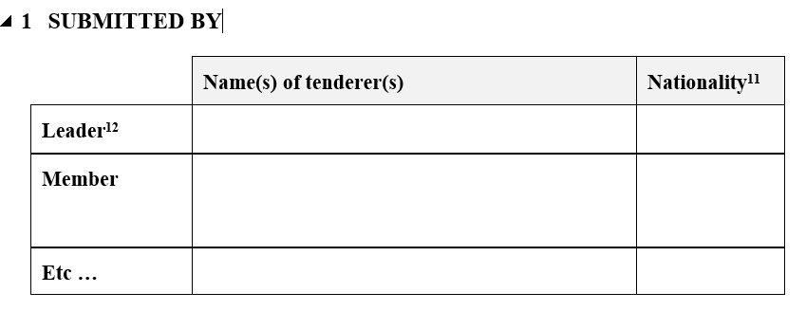
Tender form for a supply contract
In order the “Tender form for a Supply or Service contract” to be duly filled out, following six tables shall be completed and the Form shall be signed, dated and stamped (if stamp is available):
Table 1 - SUBMITTED BY

Slide 24
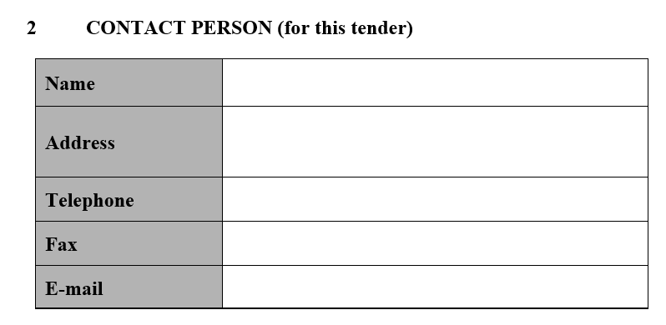
Tender form for a supply contract
In order the “Tender form for a Supply or Service contract” to be duly filled out, following six tables shall be completed and the Form shall be signed, dated and stamped (if stamp is available):
Table 2 - CONTACT PERSON

Slide 25
Tender form for a supply contract
In order the “Tender form for a Supply or Service contract” to be duly filled out, following six tables shall be completed and the Form shall be signed, dated and stamped (if stamp is available):
Table 3 - ECONOMIC AND FINANCIAL CAPACITY (Turnover)

Slide 26
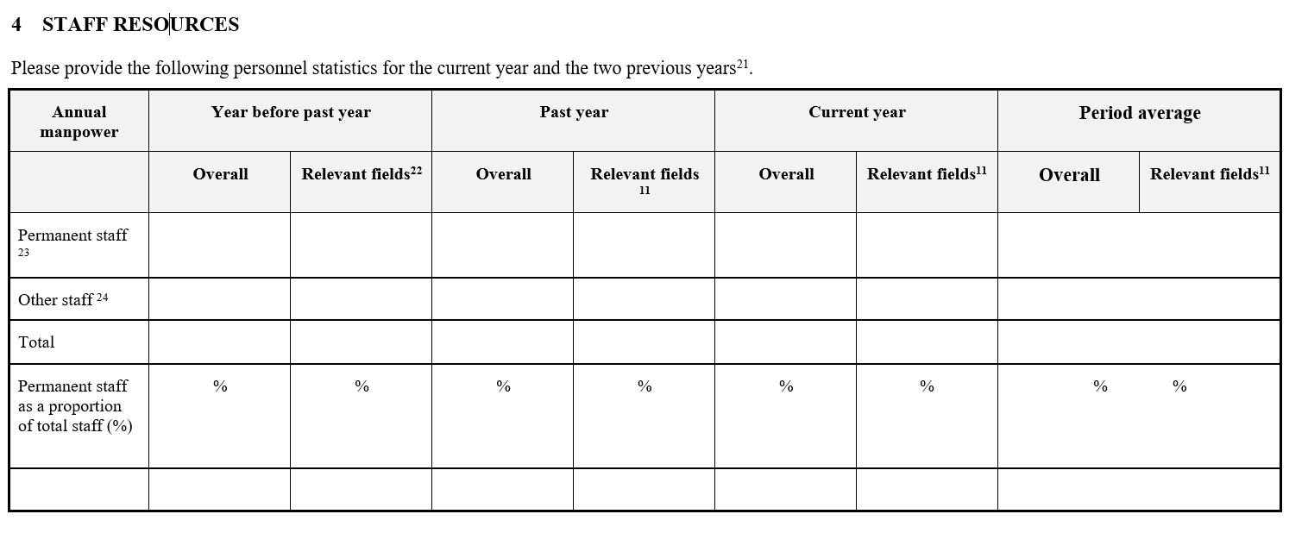
Tender form for a supply contract
In order the “Tender form for a Supply or Service contract” to be duly filled out, following six tables shall be completed and the Form shall be signed, dated and stamped (if stamp is available):
Table 4 - STAFF RESOURCES (Professional Capacity)

Slide 27
Tender form for a supply contract
In order the “Tender form for a Supply or Service contract” to be duly filled out, following six tables shall be completed and the Form shall be signed, dated and stamped (if stamp is available):
Table 5 - FIELDS OF SPECIALISATION

Slide 28
Tender form for a supply contract
In order the “Tender form for a Supply or Service contract” to be duly filled out, following six tables shall be completed and the Form shall be signed, dated and stamped (if stamp is available):
Table 6 – EXPERIENCE (Technical Capacity)

Slide 29
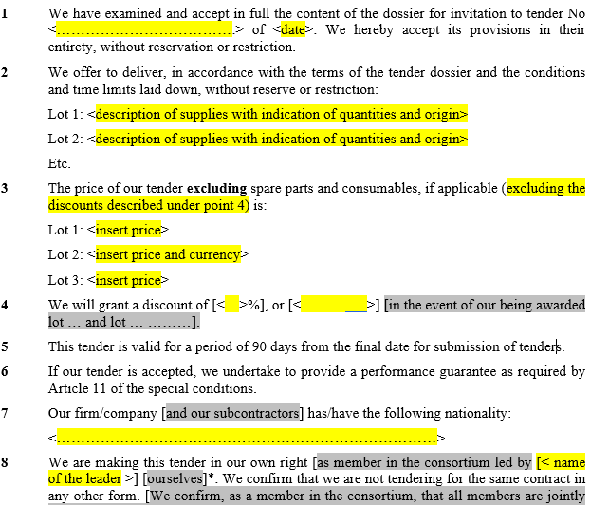
TENDERER’S DECLARATION – part of Tender form for a supply contract
TENDERER’S DECLARATION for a Supply contract shall also be duly filled out, signed, dated and stamped (if stamp is available). Most Important: in TENDERER’S DECLARATION you shall describe which lots you are tendering for (if lots are applicable); what is your offered price per lot (if lots are applicable); and if you offer any discount for combination of any lots (if lots are applicable; in the event of our being awarded lot … and lot … ………).

Slide 30
EVALUATION
Selection and Award Criteria
In procedures for the procurement of Supplies, the evaluation of offers is carried out using the following criteria:
Administrative compliance
Technical compliance
Financial compliance
Contract is awarded to the Lowest Priced administratively and technically compliant tender
Note: For Supply contracts the award criteria is always the Lowest Price, therefore no scoring of technical offers is done for procurement of Supplies.

Slide 31
EVALUATION
Selection and Award Criteria
In procedures for the procurement of Services, the evaluation of offers is carried out using the following criteria:
Administrative compliance
Technical compliance
Financial compliance
Contract is awarded to the administratively compliant, first highest ranked tenderer after combined technical and financial evaluation.
Note: For Service contracts the award criteria is always Best Quality-Price Ratio, with 80% for technical offer and 20% for financial offer; i.e. first technical offers are evaluated with technical scores, then financial offers are evaluated with financial scores, and as a result of combined technical and financial evaluation, the tenderer who is first highest ranked tenderer gets the contract.

Slide 32
EVALUATION
Contract Categories & Contract Currency
In procedures for the procurement of Services and Supplies, there are mainly 2 contract categories:
First is a usual/conventional contract, i.e. with specific deadlines for delivery of Supplies or provision of Services - from the contract signature date.
Second is a Framework Contract (FWC). The signature of the FWC imposes no obligation on the Contracting Authority to purchase the Services or Supplies covered by the contract. The Services or Supplies will be ordered on demand by EUMM via Order Forms during the contract implementation. Usually, FWCs are signed for 1 or 2 years (sometimes can be longer or shorter periods).
For any contract category the contract currency can be in GEL or in USD or in EUR. If it’s in foreign currency, the payments anyway will be made in GEL, by the USD/GEL or EUR/GEL selling rate of the commercial bank (TBC Bank) serving EUMM Georgia, applicable on the date of the transaction.

Slide 33
CONTRACT IMPLEMENTATION
The supplier which is recommended for award, will receive a successful notification letter and the contract to be signed. Unsuccessful tenderers will also receive respective letters with explanation why their tender was not successful or admissible.
The contract might have immediate commencement or may be activated using Purchase Orders (e.g., framework contracts).
The contractor will have a focal point in the Mission, i.e. the Contract Project Manager, who will be responsible for the supervision of contract implementation.

Slide 34
CONTACTS
Address
49 Krtsanisi Street
0114 Tbilisi
Georgia
Email
tenders@EUMM.EU
www.eumm.eu
Follow Us
Facebook.com/EUMM
Twitter.com/EUMM
Youtube.com/ EUMM

Slide 35
QUESTIONS ?

Slide 36
THANK YOU
For Your Precious Time and Attention.

